Slide 1


AI and Monte-Carlo simulations in medical physics
David Sarrut
CREATIS, CNRS UMR5220, Inserm U1044, INSA-Lyon
Université Lyon 1, France

Slide 2
Image reconstruction
Inverse problems
Monte Carlo simulations
Deep learning
Radiation based imaging
Radiation based therapy

Slide 3
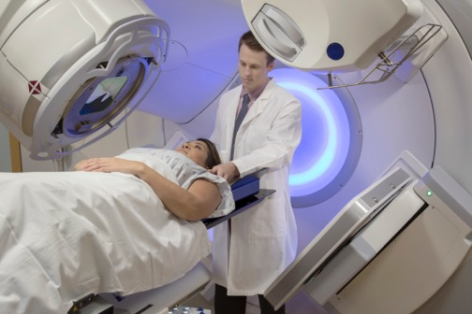
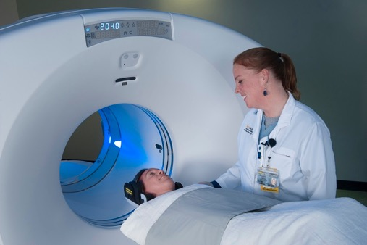
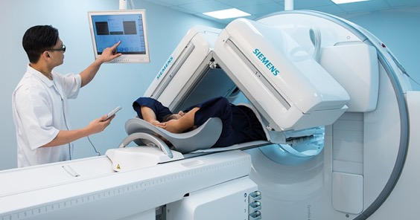
Research applications
Radiation therapy
Radiology
Diagnostic
Therapy
Cancer
Nuclear Medicine

Slide 4
Artificial intelligence
Monte Carlo simulations

Slide 5
Artificial intelligence
Monte Carlo simulations

Slide 6
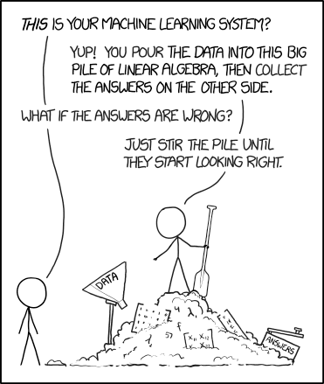
https://xkcd.com/1838

Slide 7
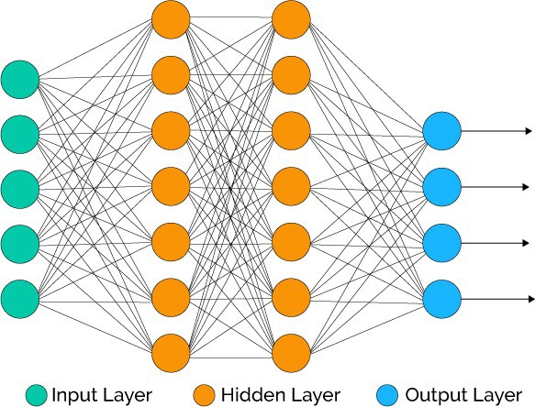
Deep Learning (DL)
Step1: learn a model (training)
  Input training database
  from numerous independent samples
  Neural network architecture
  Learning method (optimisation)
Step2: use the model (inference)
  Get new input data
  Apply the NN model to get output

Slide 9
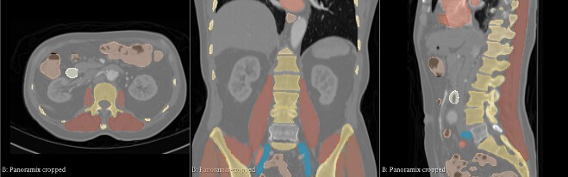
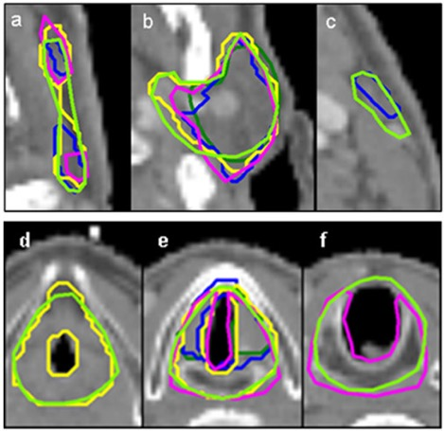
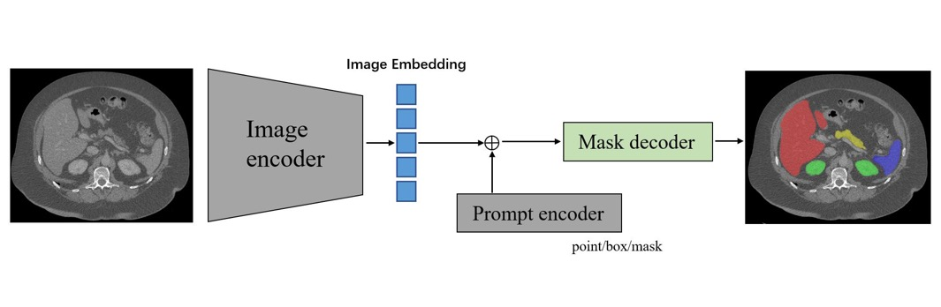
Today’s game changer
Total Segmentator
Moose
Medical SAM
…

Slide 10
Artificial intelligence
Monte Carlo simulations

Slide 11
Artificial intelligence
Monte Carlo simulations

Slide 12
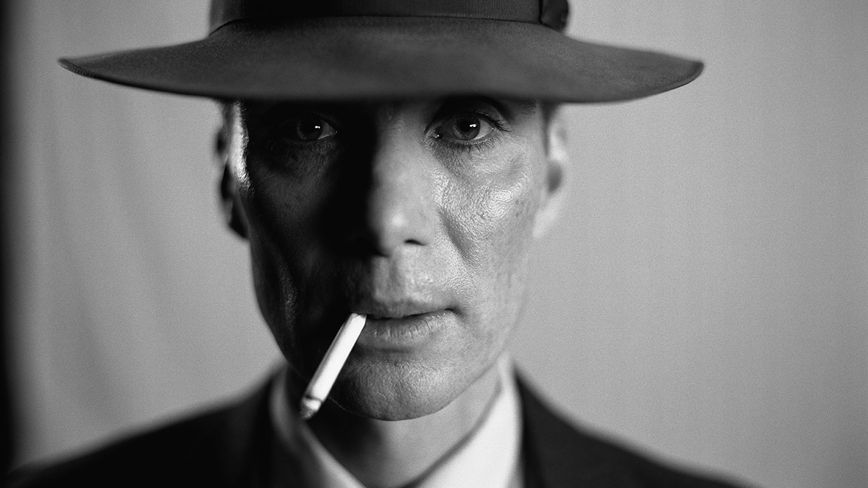
Robert Oppenheimer
Notes:
Robert Oppenheimer. Do you know this guy ? For those who know the story, this is in Los Alamos, once Oppenheimer left, after the war, during the building of the “super bomb” (hydrogen bomb) that MC simulations for nuclear physics was first used, by Ulam+XXX.
Since them, this simulation methods has proven to be very useful for medical physics. In RT for Linac and dose comp, but also in med nuc for SPECT and PET devel, also reconstruction, also dose.

Slide 13
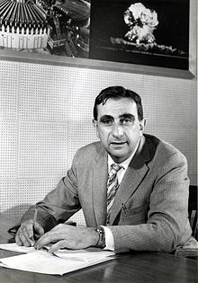
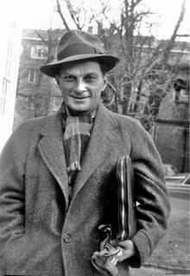
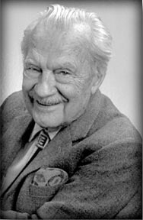
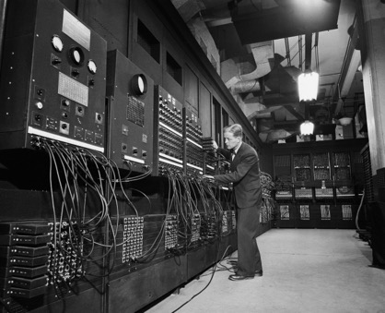
Nuclear physics Monte Carlo simulations
ENIAC 1947
Edward Teller
Stanisław Ulam
Nicholas Metropolis
Metropolis, Nicholas; Stanislaw Ulam (1949).
"The Monte Carlo method". Journal of the American Statistical Association. 44 (247): 335-341 doi:10.1080/01621459.1949.10483310

Slide 14
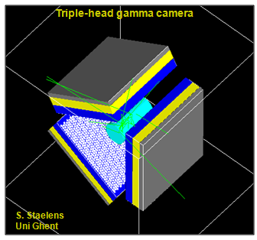
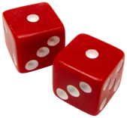
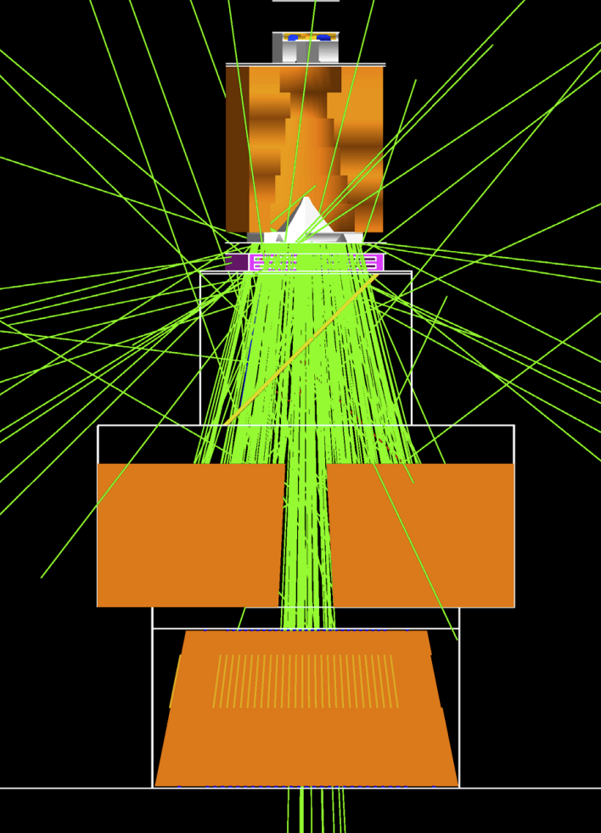
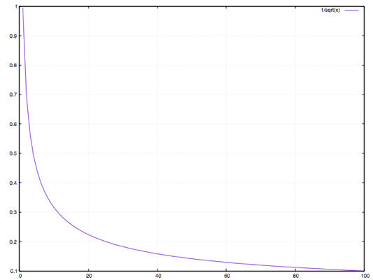
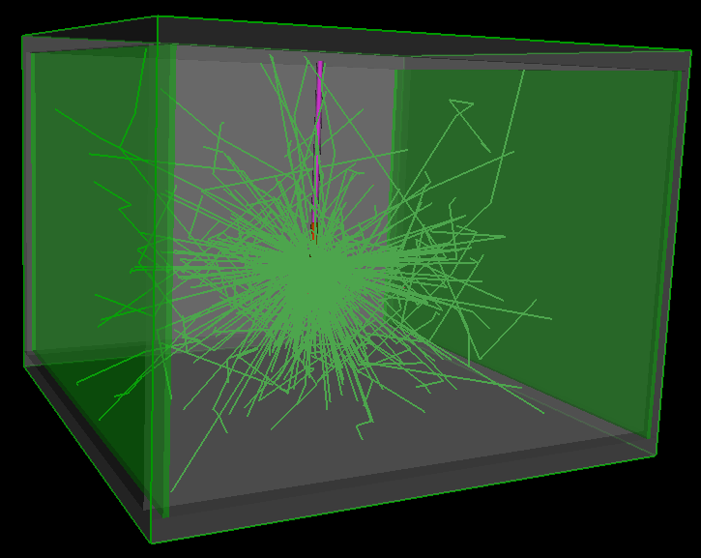

Monte Carlo simulations in medical physics
Electron
Reference method
Slow method
Photon
Uncertainty
Nb of particles

Slide 15
Artificial intelligence
Monte Carlo simulations

Slide 16
AI and MC
Lot of work in HEP
Use AI with MC input or use AI in MC process
[Sarrut et al Frontiers 2021]

Slide 17
DL-based Monte Carlo denoising
Post-processing, CNN-based denoising
Training dataset: pairs of high-noise/low-noise dose distributions
Photon, proton dose ; SPECT images
10–100 times fewer particles
Dose gradients preserving ? Memory ?
[Fornander2019]
[Neph2019]
[Peng2019]
[Javaid2019]
[Reymann2019]
[Kontaxis2020]
[Javaid2021]
[Bai2021]
[Javaid2021]
WARNING : need for objective task-based evaluation of DL denoising !

Slide 18
AI + MC example: learning Linac phase-space

Slide 19
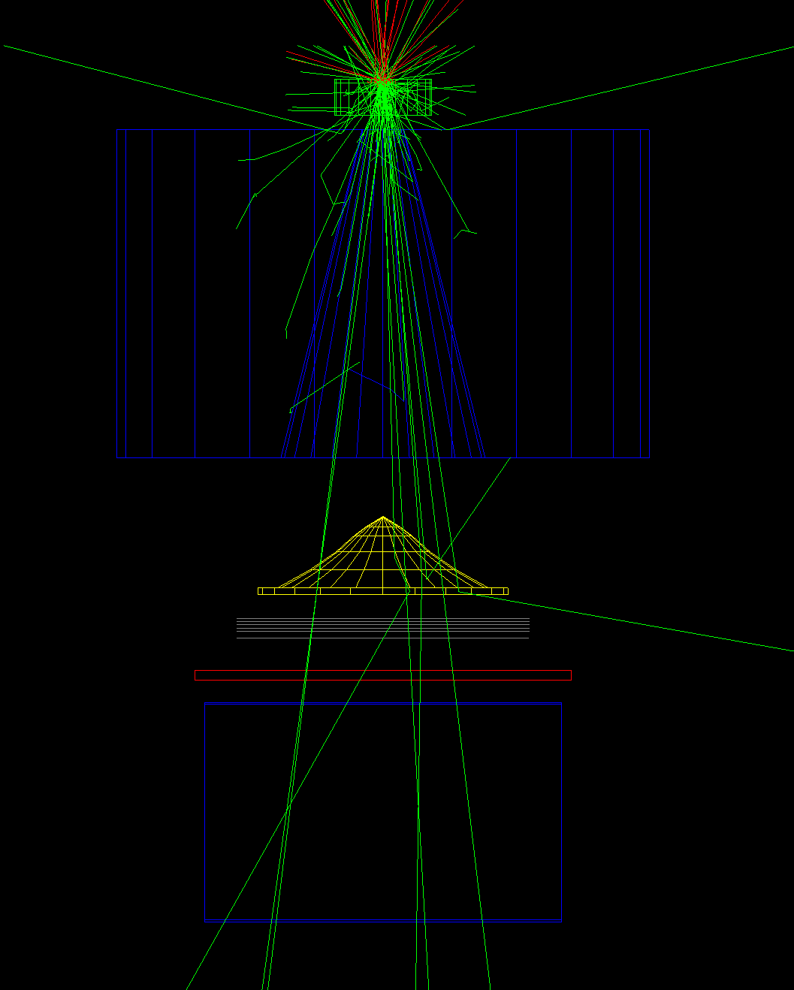
Radiation Therapy Linac head simulation
e- beam
Few photons exiting
VRT (brem splitting)
Goal: determine beam characteristics
(energy, position, direction distributions)

Slide 20
Phase Space (PHSP)
Store beam properties as Phase Space
  A PHSP is a list of particles (around 10⁸, 10⁹)
  Properties: E, x, y, z, dx, dy, dz, w, (time)
Advantages:
  Computed only once
  Fast to use
  Can be shared
Drawback
  Several GB
  When a cluster is used, should be shared among workers
  Limited number of particles
  Extensive description, not a model
  Latent variance [Sempau2001]
Example of dependence of direction φ and energy

Slide 21
GAN: Generative Adversarial Network
Training dataset
  Dimension d=7
  Samples of unknown
Generator
Discriminator
[Goodfellow et al 2014]
G
D
1|0

Slide 22
Loss function
GAN notoriously difficult to train
Alternative formulations: Wasserstein GAN [Arjovsky 2017]
“Earth-mover” distance (EMD) : cost of the optimal transport
Un-tracktable in practice, but approximated:

Slide 23
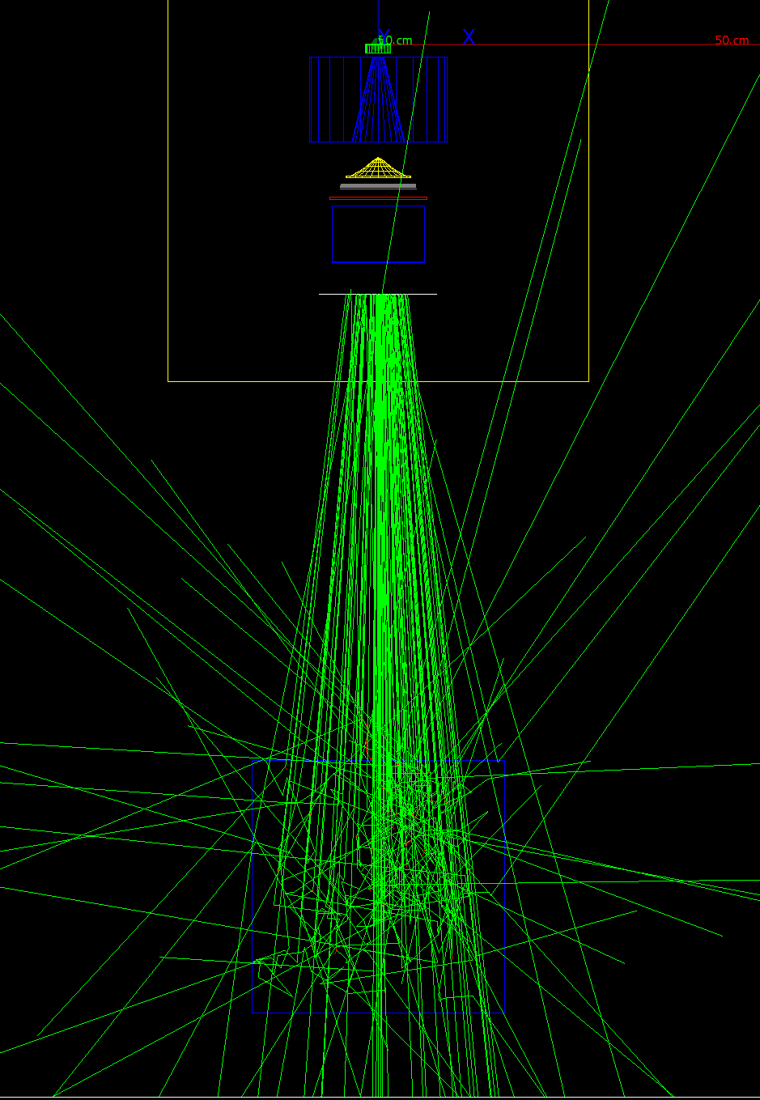
Results
LINAC head
Difference/uncertainty
PHSP or GAN plane
Dose distribution in water from PHSP
10⁸ primary photons
Compare dose between:
  PHSP1 vs PHSP2
  PHSP1 vs GAN
Voxel by voxel dose comparison
Beam
Waterbox

Slide 24
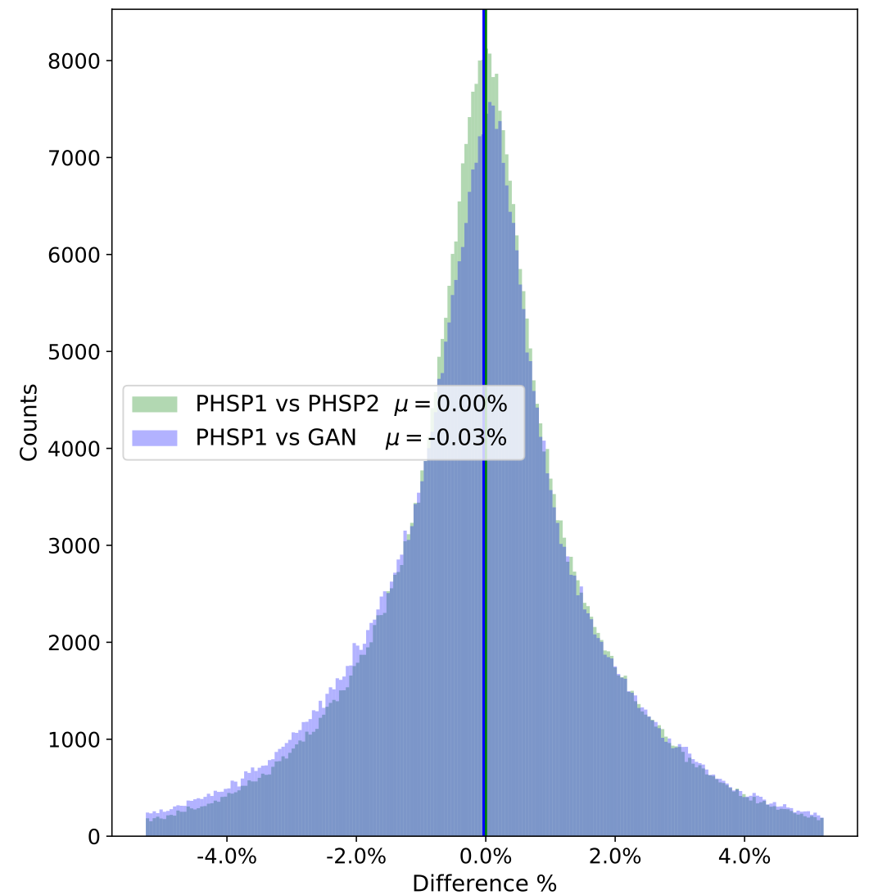
Results
Distributions of relative differences between
PHSP1 and PHSP2
PHSP1 and GAN
PHSP = 3 GB
GAN = 10 MB
Vertical lines indicate the mean differences
Difference relative to the prescribed dose

Slide 25
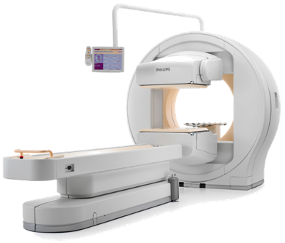
SPECT simulation
Part1: from emission to patient exit
Part2: track gammas inside the detector

Slide 26
Outgoing gamma forward model
Track gammas inside the patient
Learn outgoing gammas probability distribution
Direct outgoing gammas
Scatter outgoing gammas
Absorbed gammas
x = emitted gammas
y = outgoing gammas

Slide 27
GAN: Generative Adversarial Network
Training dataset
  Dimension d=7
  Samples of unknown
Generator
Discriminator
[Goodfellow et al 2014]
G
D
1|0

Slide 28
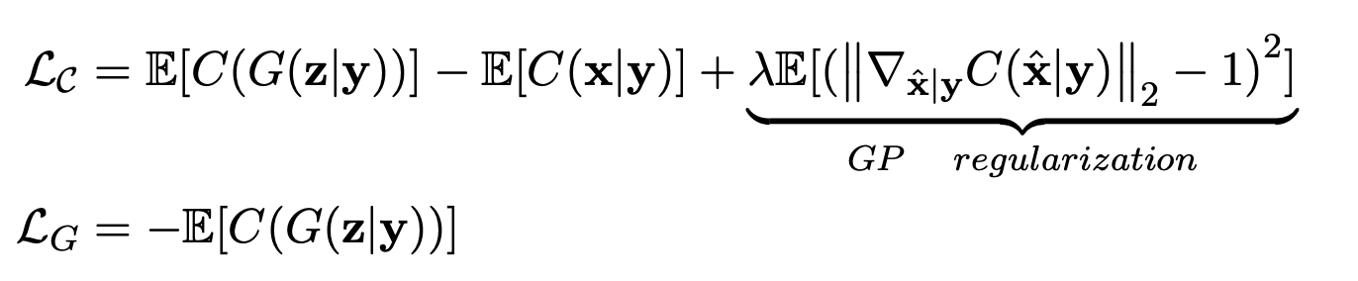
Conditional GAN
Train with one phantom (CT, patient) with homogeneous activity
[Saporta et al, PMB 2022]
Regularisation: gradient penalty
Conditional input activity map
[Gulrajani 2017]
Warning : the D (Discreminator) is called C (Critic) here

Slide 29
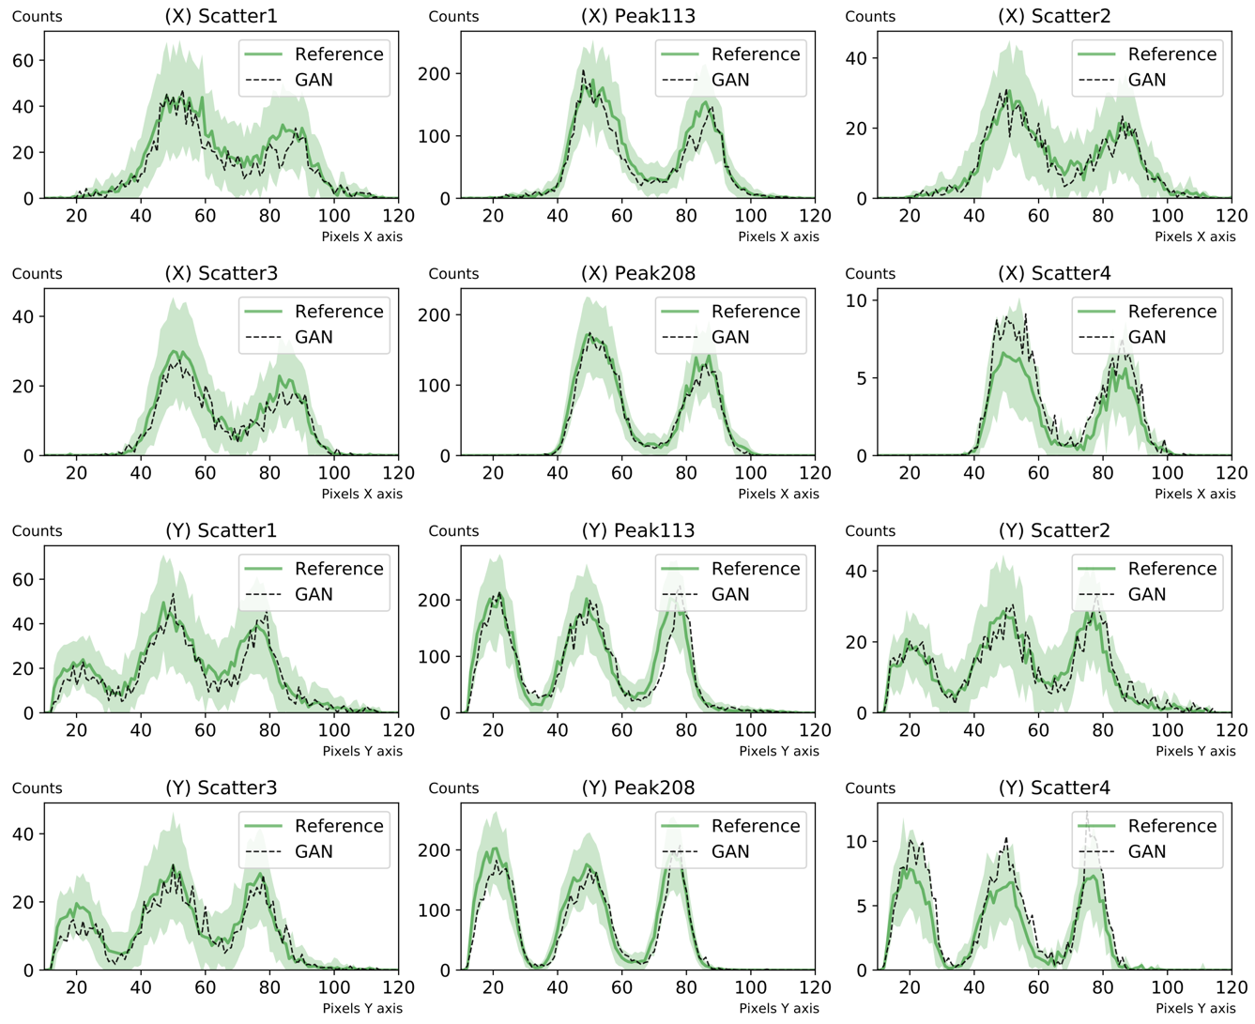
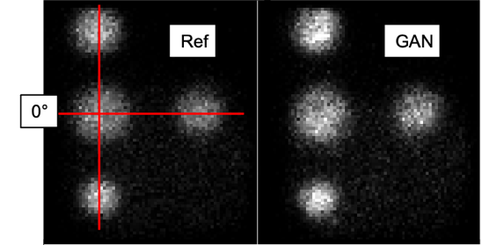
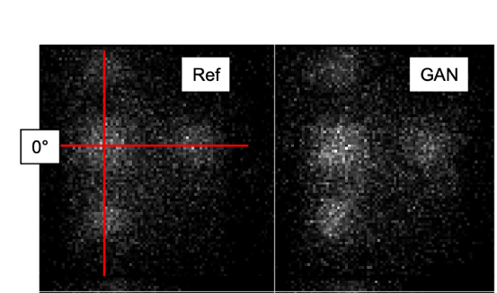
Results
X
Y
2D projections
Lu177
(2x peaks & 4 x scatter)

Slide 30
SPECT simulation
Part1: from emission to patient exit
Part2: track gammas inside the detector

Slide 31
Angular Response Function (ARF)
Train with MC detected events
Detection probability
Neural Network
[Song2005] [Descourt2010] [Rydeen2018]
[Sarrut2018]

Slide 32
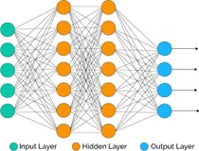
Angular Response Function (ARF)
Train with MC detected events
Detection probability
Neural Network
ARF
[Song2005] [Descourt2010] [Rydeen2018]
[Sarrut2018]
Speedup : ~ x10 (but different noise)

Slide 33
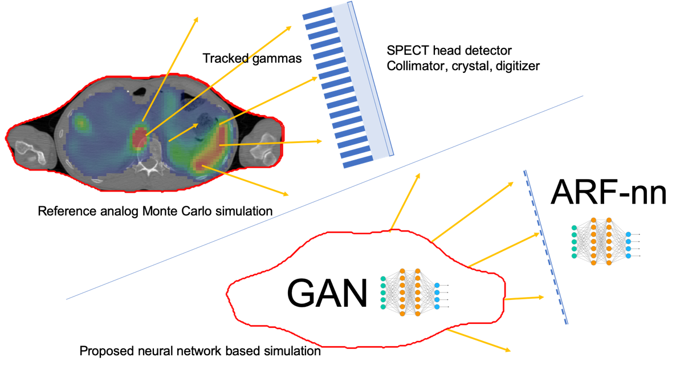
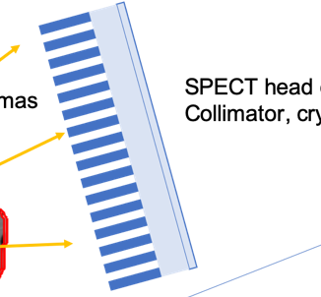
Combine GAN and ANN
Computation gain
4x to 400x
Simple MC : low gain
Complex MC : high gain

Slide 34
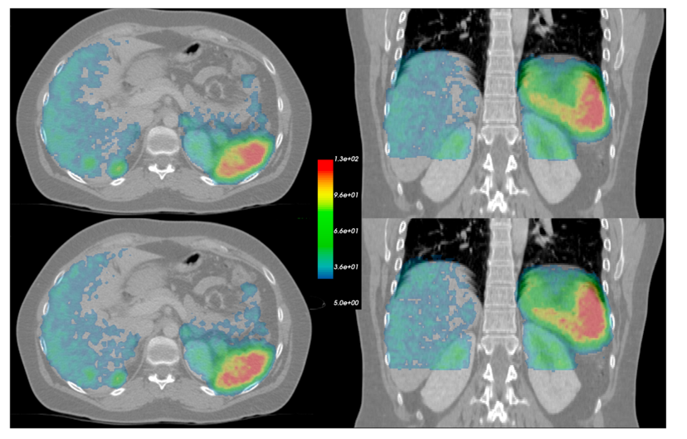
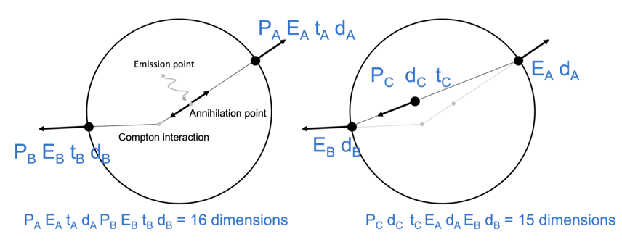
PET GAN
Back-to-back GAN photon source for PET Monte Carlo simulation
[Sarrut et al, PMB 2023]

Slide 35
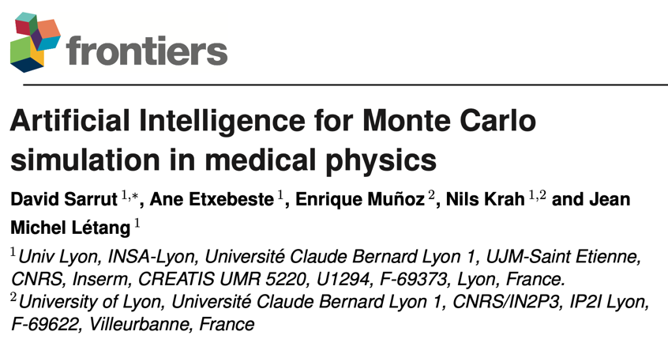
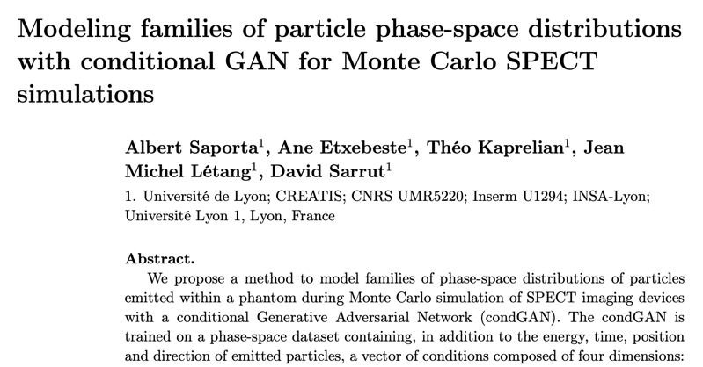
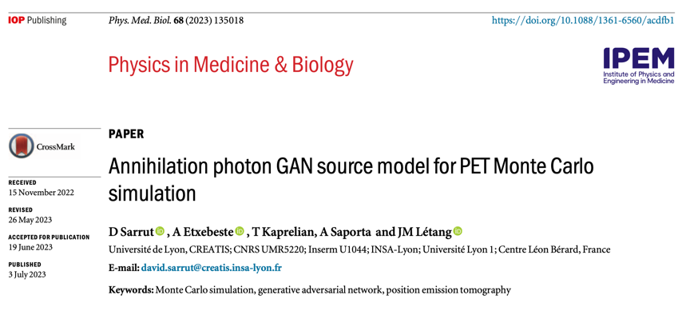
[Frontiers in Physics 2021]
[PMB 2018]
[PMB 2019]
[PMB 2022]
[PMB 2021]
[PMB 2023]

Slide 36

Conclusion
Monte Carlo’s
AI and MC can be combined in various ways
Data-driven from MC simulations (/!\ crap-in, crap-out)
GAN to produce complex particles distributions
Open science, available toolkits
Limitations
  Training dataset size ?
  Unclear modeling of “rare” events (e.g. pairs prod)
Challenges
  GAN as a “forward model” ?
  How to condition the attenuation image ?
  Evaluation is difficult

Slide 37

(shameless advertisement)

Slide 38
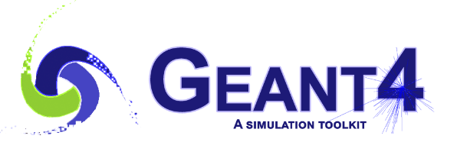



GATE 10 (beta)
New version is coming (current is beta04)
Macros script replaced by Python scripts
pip install opengate
Multi-thread,
Faster, embeddable, powerful
SPECT, PET, Linac, proton, dose …
+100 tests and examples
Open and Open-source
https://github.com/OpenGate/opengate

Slide 39

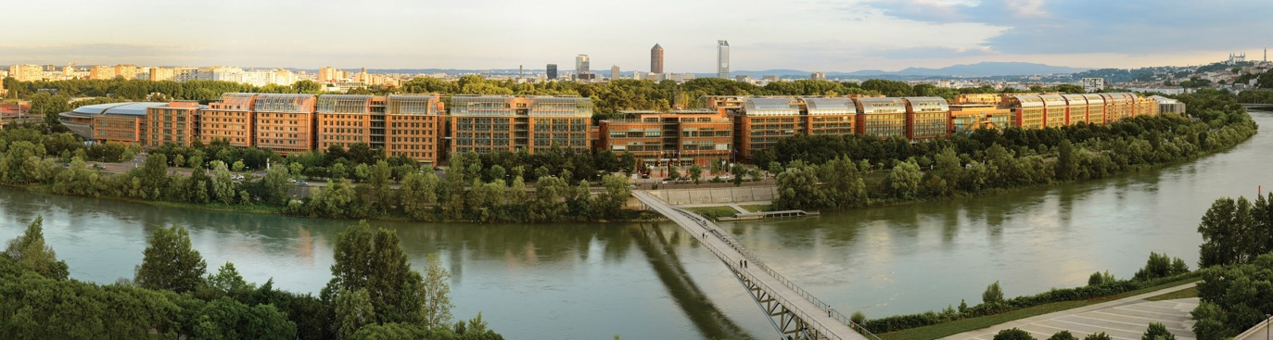
www.iccr2024.org
8 - 11 July 2024
Lyon - France
20th edition
Abstract deadline : January 2024
Treatment Planning
Imaging
Dose Delivery
Quality Assurance
Artificial Intelligence
…
using Computers
for Radiation Therapy

Slide 40
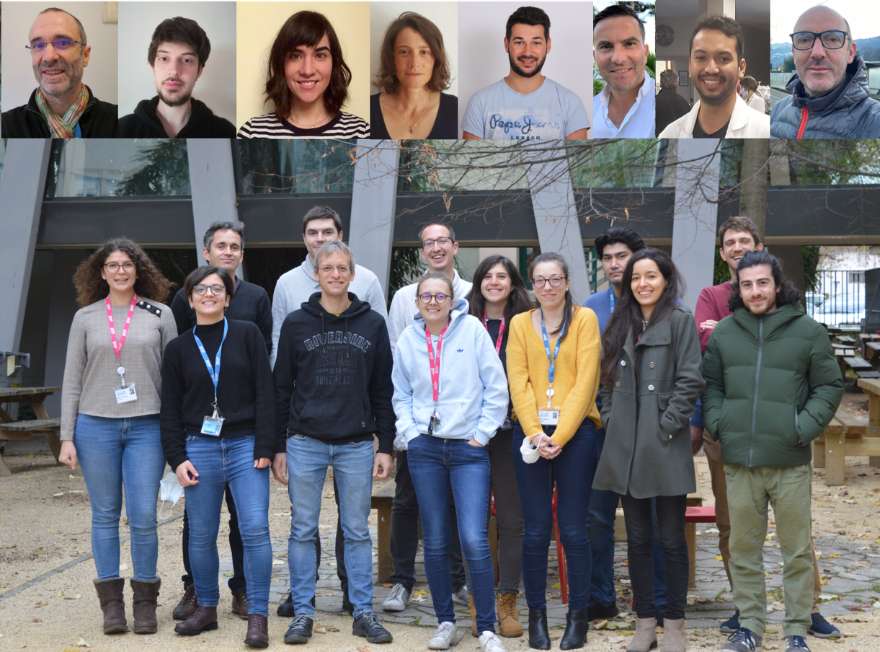


Lyon, France
Thanks for your attention !

